Slide 1

Predicting Falcon 9 Landing Success: A Data-Driven Approach to Saving Millions.
Capstone Project - IBM Data Science Professional Certificate
https://github.com/andyjoap/Final-Project-SpaceX
Author: Andres Perucca

Slide 2

EXECUTIVE SUMMARY
Objective: Develop a machine learning pipeline to predict the success of SpaceX Falcon 9 first-stage landings.
Problem: Each launch costs roughly $62 million. Reusing the first stage saves millions, making accurate predictions a high-value asset for mission planning.
Key Findings:
Payload mass and orbit type significantly influence success.
Launch sites are strategically located near coastlines for safety.
Best Model: Decision Tree (o el que te haya dado mejor), reaching an accuracy of [Tu valor, ej. 94% o 83%].

Slide 3

INTRODUCTION
Background: SpaceX has revolutionized space travel by introducing reusable rocket technology. The Falcon 9’s first stage can land on ground pads or autonomous spaceport drone ships (ASDS).
The Problem: Landing failure results in the loss of expensive hardware. Predicting these outcomes helps in risk assessment and insurance cost estimation.
Objective: To analyze historical launch data and build a classification model that predicts whether the first stage will land successfully based on mission parameters.

Slide 4

Data Collection & Wrangling Methodology
Data Collection: SpaceX REST API and Web Scraping (Wikipedia) for historical launch data.
Data Wrangling: Handling missing values in PayloadMass, creating dummy variables for categorical features (Orbit, Site), and label encoding landing outcomes (1 = Success, 0 = Failure).
Analysis Tools: Python (Pandas, Numpy), SQL for structured queries, Folium for spatial analysis, and Scikit-Learn for modeling.

Slide 5
EDA & Interactive Visual Analytics Methodology
Exploratory Data Analysis (EDA): Used Pandas and Seaborn to find correlations between variables like Payload Mass and Launch Site.
SQL Analysis: Leveraged SQLite to perform complex queries, such as identifying the total number of successful missions and ranking launch sites by volume.
Exploratory Data Analysis (EDA): Performed comprehensive data exploration using Pandas and Seaborn to identify correlations between payload mass, launch sites, and mission success.
Statistical Visualization: Generated various charts (Scatter plots, Bar charts, and Line graphs) to visualize trends over time and the performance of different rocket versions.

Slide 6
Predictive analysis methodology
Objective: To build and compare four supervised machine learning models to classify whether a mission's first stage will land successfully.
Algorithms Selected:
Logistic Regression: Baseline model for binary classification.
Support Vector Machine (SVM): Effective in high-dimensional spaces.
Decision Tree: Non-linear model capable of capturing complex decision rules.
K-Nearest Neighbors (KNN): Instance-based learning for local pattern detection.
Standardization: Applied StandardScaler to the feature set ($X$) to ensure all variables have a mean of 0 and standard deviation of 1, preventing features with larger scales (like Payload Mass) from biasing the models.
Hyperparameter Tuning: Utilized GridSearchCV with 10-fold cross-validation for each model to identify the optimal parameters (e.g., regularization strength $C$, kernel types, and maximum tree depth).
Data Splitting: Divided the processed dataset into Training (80%) and Testing (20%) sets to evaluate the models' generalization ability on unseen data.
Key Findings:
Top Performer: The Decision Tree achieved the highest accuracy (88.89%), correctly predicting more outcomes on the test set than its counterparts.

Slide 7
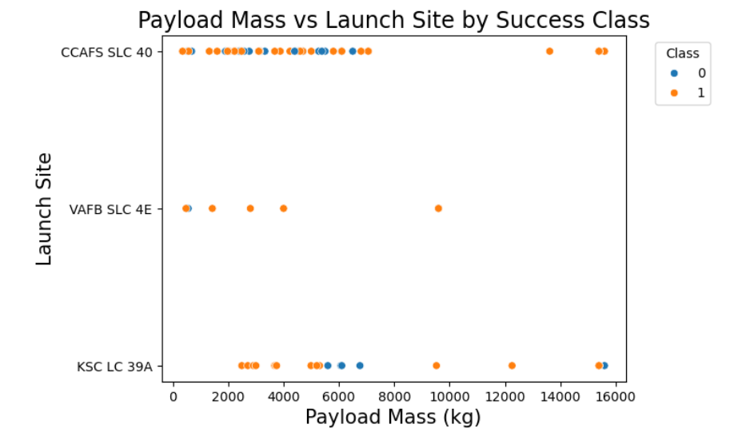
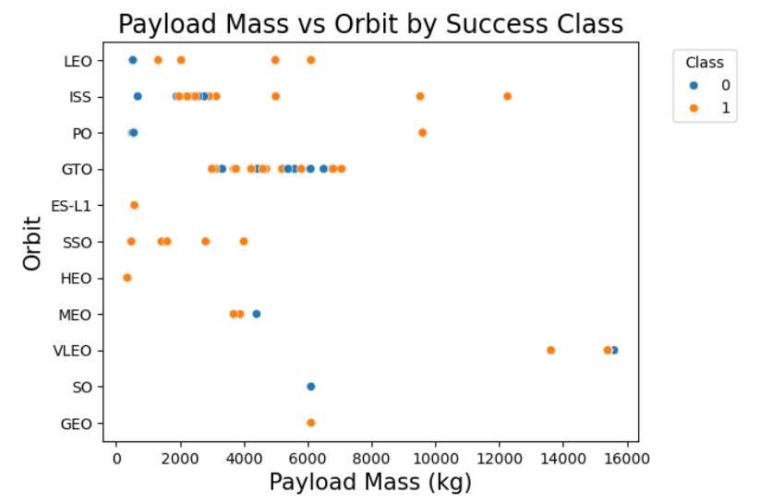
EDA with visualization results

Slide 8
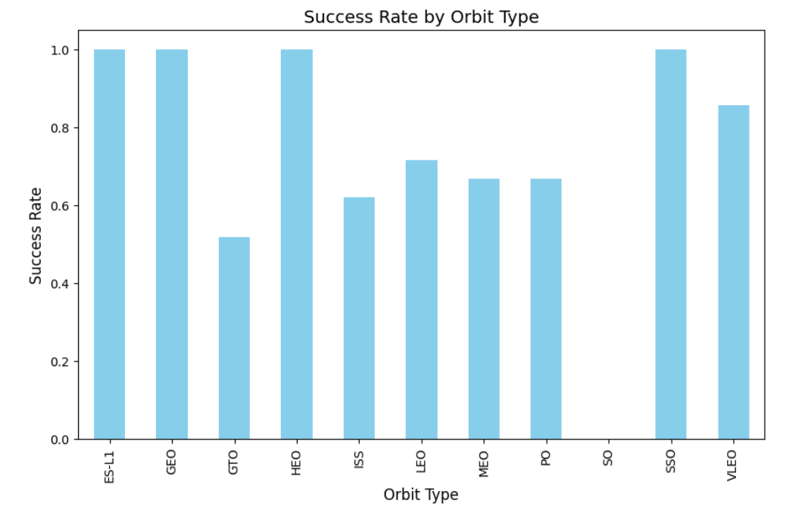

Slide 9
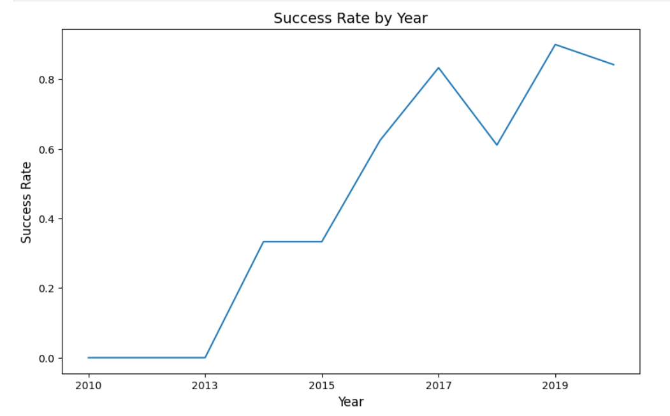

Slide 10
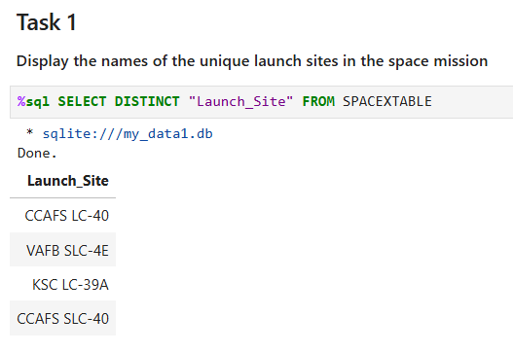
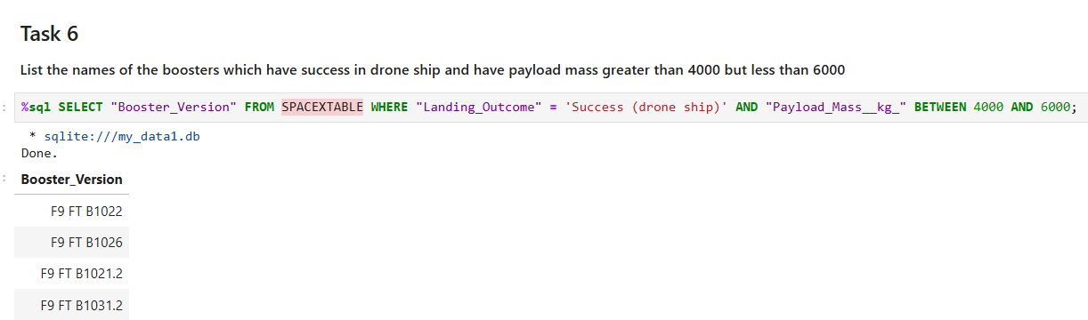
EDA SQL Results

Slide 11
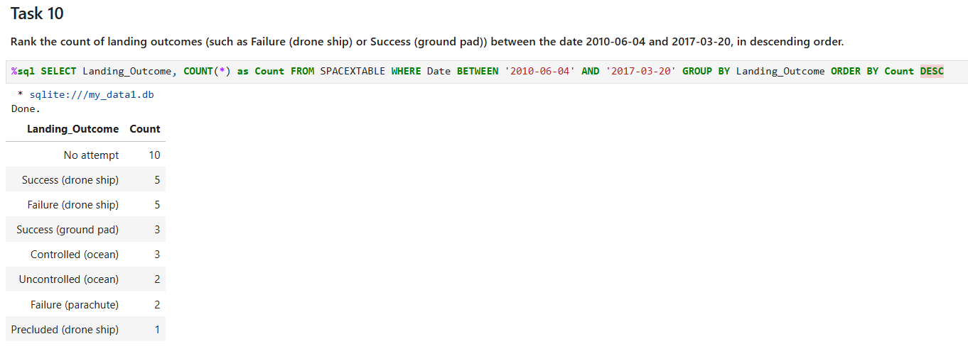

Slide 12
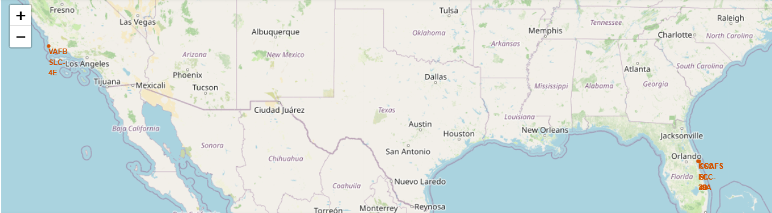
Interactive map results using Folium

Slide 13
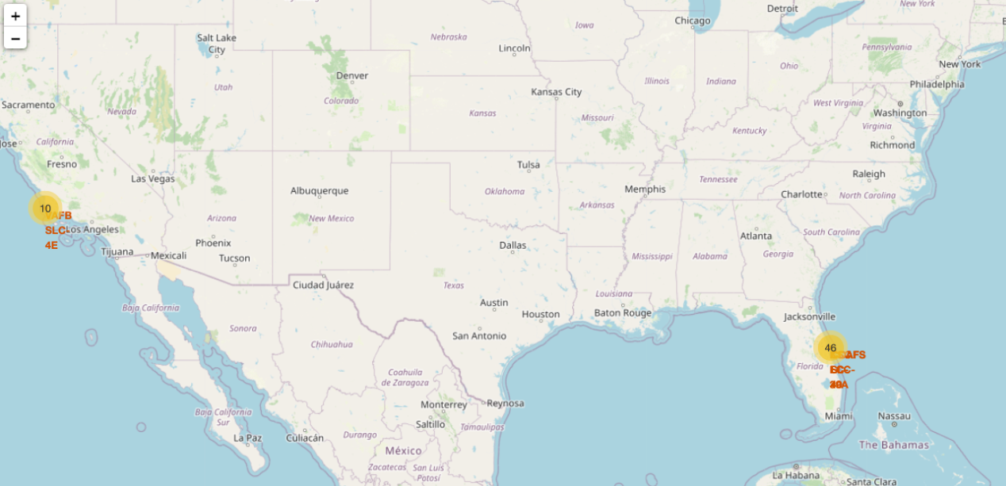

Slide 14
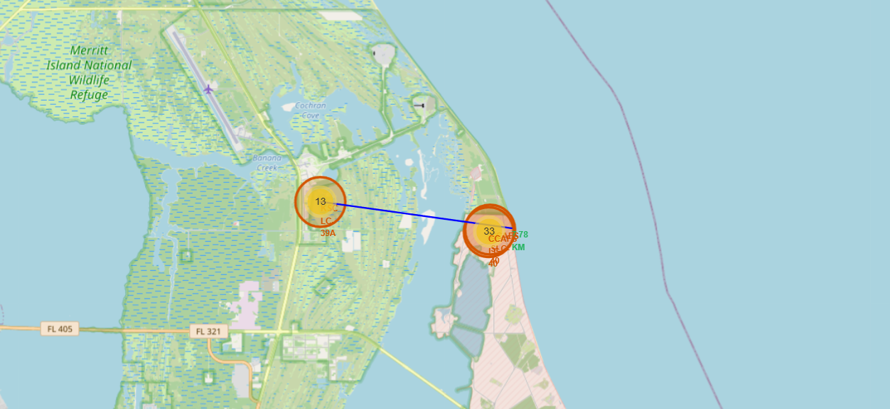

Slide 15
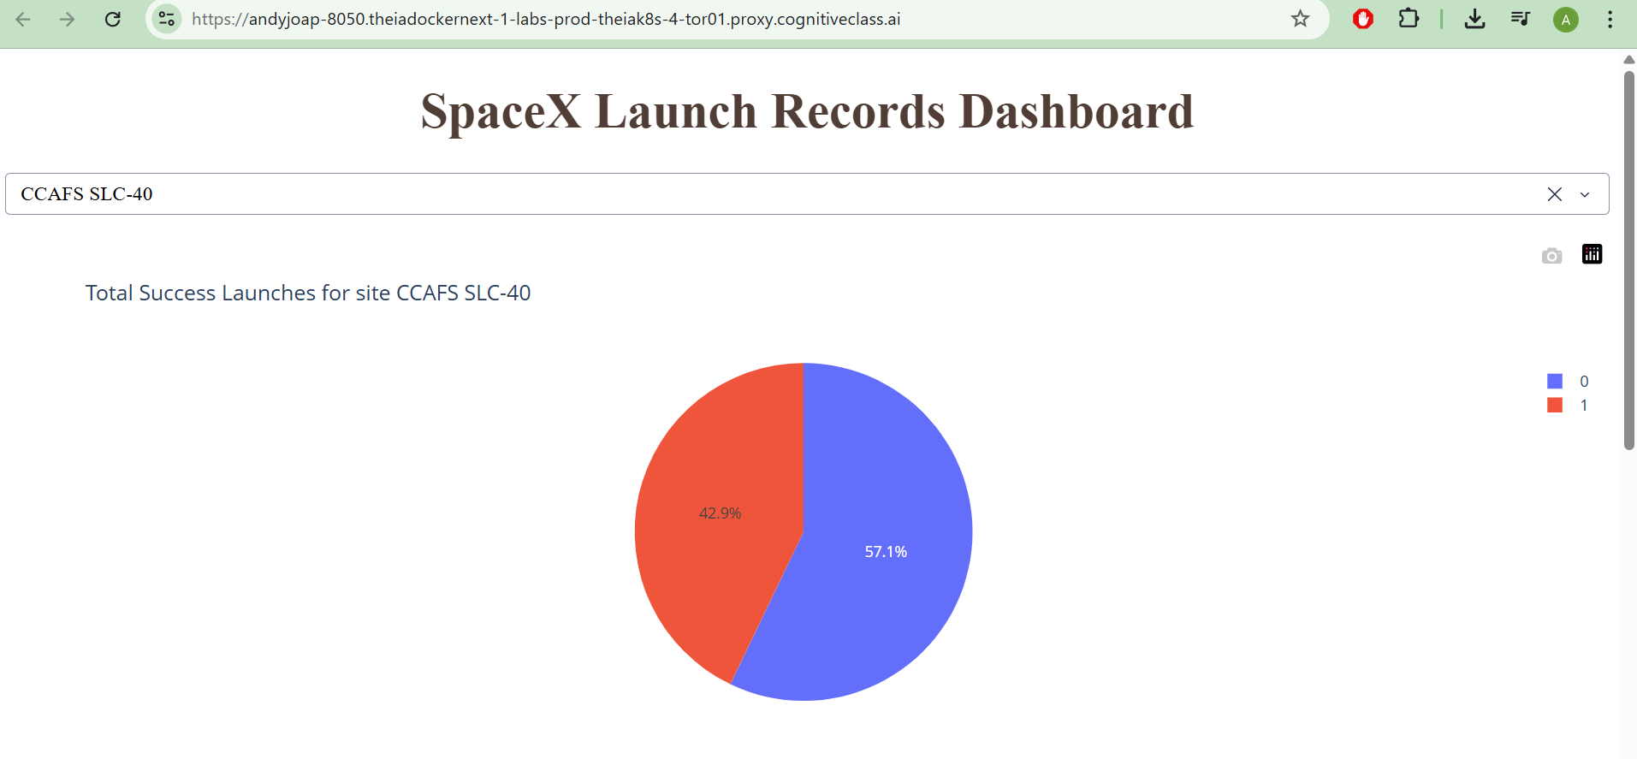
Plotly Dash dashboard results

Slide 16
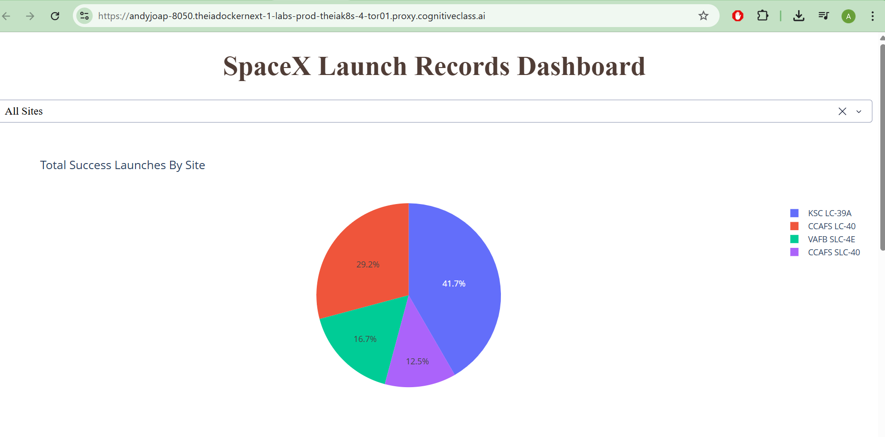

Slide 17
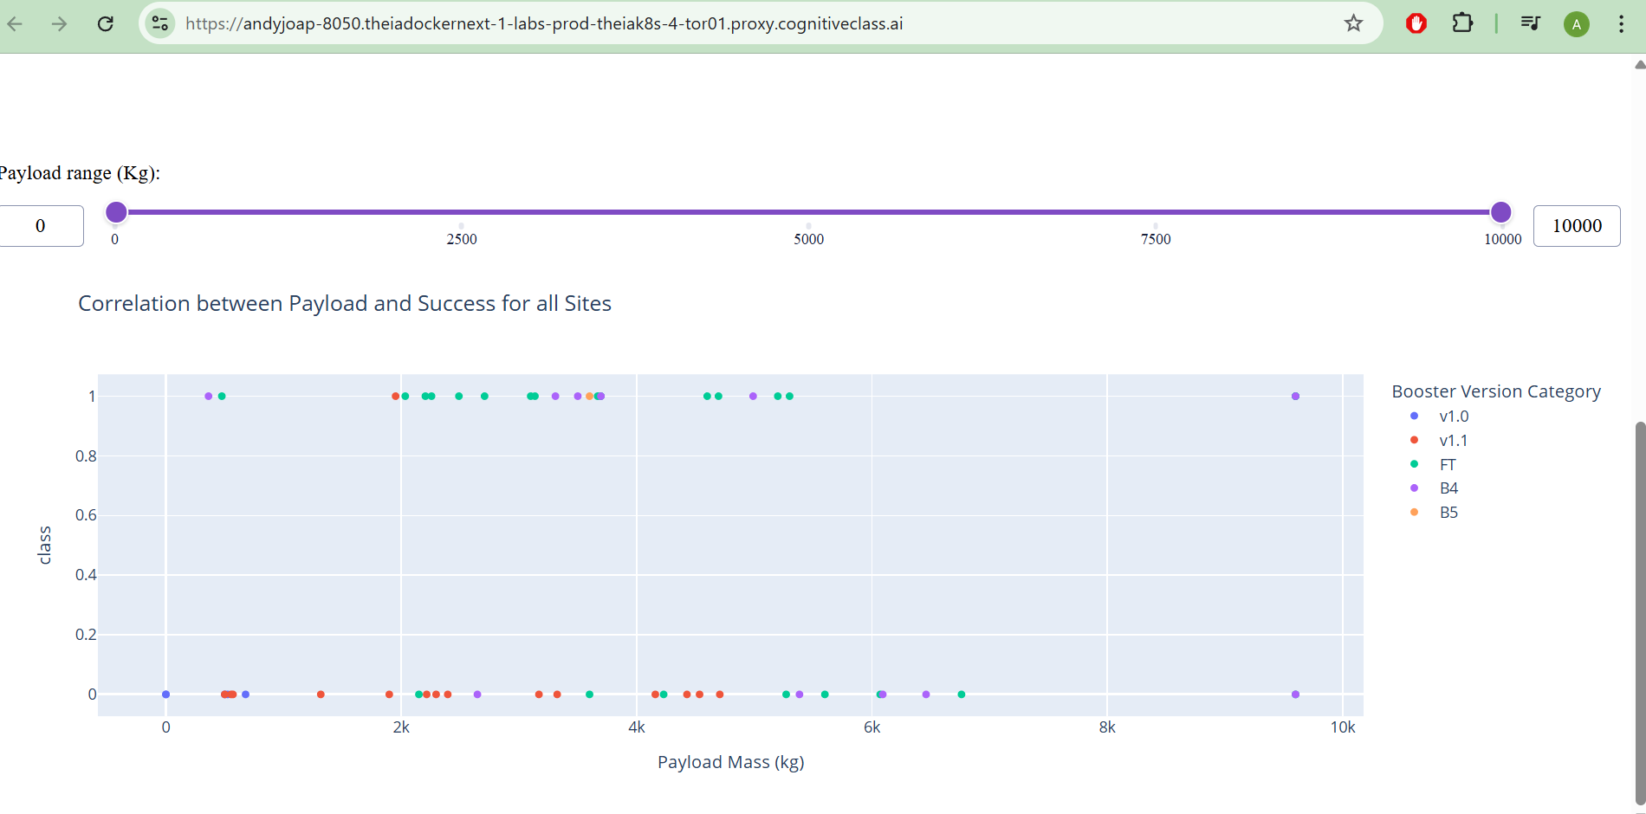

Slide 18
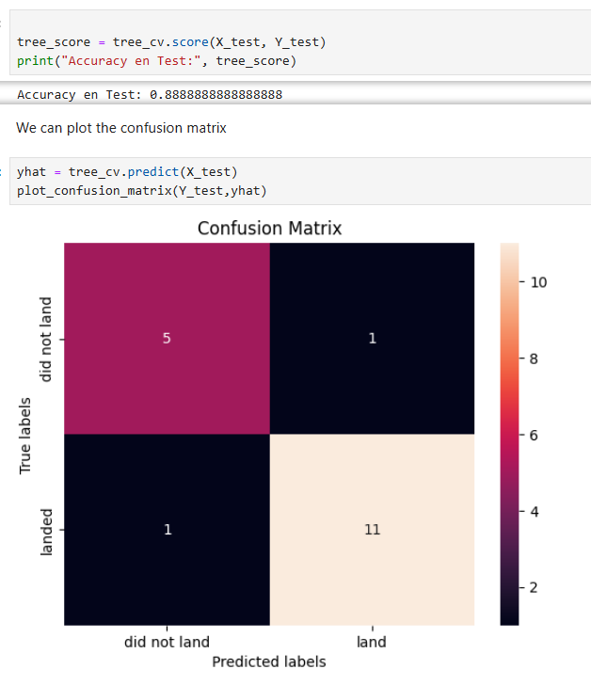
Predictive analysis (classification)
Decision Tree Score:
0.88

Slide 19

CONCLUSION
Feasibility of Prediction: The project successfully demonstrates that SpaceX Falcon 9 landing outcomes can be predicted with high accuracy (88.89%) using machine learning models.
Key Success Drivers: Through our analysis, we identified that Payload Mass and Orbit Type are the most critical factors influencing the success of a first-stage recovery.
Strategic Insights:Launch sites are strategically placed near the coast to ensure safety, confirming that geographical factors are as important as technical ones.The learning curve is evident: success rates have improved significantly as the number of flights increased.
Economic Impact: By providing reliable landing forecasts, SpaceX can better manage its fleet of reusable rockets, potentially saving $40M+ per mission and optimizing global space logistics.
Future Work: Further improvements could be achieved by incorporating real-time weather data (wind speeds, sea state) and increasing the dataset size as more launches occur.

